Slide 1
19CSE205 Program Reasoning Program Verification
Dr.S.Padmavathi
CSE, Amrita School of Engineering
Coimbatore

Slide 2
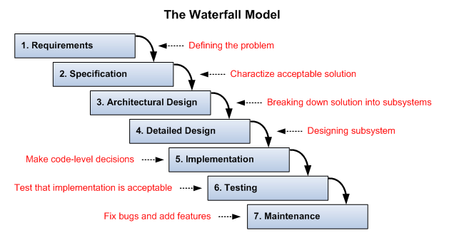
Simple steps in writing a software

Slide 3
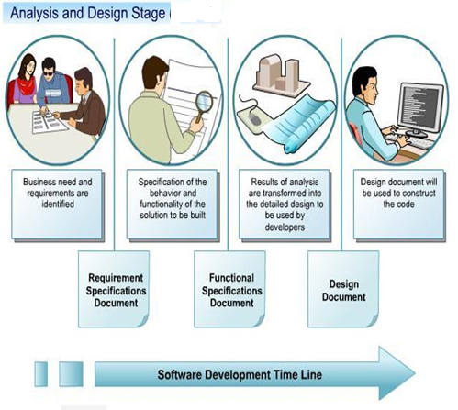
Simple steps in writing a software
How do you prepare these documents ?

Slide 4
Writing a requirement and functional specification document
Requirements specification document(s)
Serve as a contract between client and developer/provider
Identify functional capabilities of a system
Identify non-functional and environmental constraints (expected behaviour of the system)
In general, functional requirements include
Input/output, Processing, Error handling.
In general, non-functional requirements include:
Reliability, Safety, Security, Performance, Delivery, Help facilities.

Slide 5


Writing a requirement and functional specification document
Functional requirements for a video player
Icon | Index | Function Name | Description
 | V1 | Play | Clicking the play causes the video to begin playing. If the video was just paused, then playing the video resumes at the point of pausing. If the video has yet to start playing then a new computer window is created and video begins playing in the window. So long as the video is playing the pause/play button functions as a pause button displaying a pause button image
 | V2 | Pause | Clicking the pause button causes the video to pause at the current play location If the video has already finished playing, then this button has no effect. Clicking the pause button causes the pause/play button to function as a play button, displaying a play button image

Slide 6


Writing a requirement and functional specification document
Functional requirements for a video player (contd)
Icon | Index | Function Name | Description
 | V3 | Increase Volume | Clicking the increase volume button while the volume is less than maximum 80 dB level causes the volume to increase by 5 dB Clicking the increase volume button while volume is at 80 dB level does nothing.
 | V4 | Decrease Volume | Clicking the decrease volume button while the volume is greater than silent (0 dB) level causes the volume to decrease by 5 dB Clicking the decrease volume button while volume is at silent level does nothing.
Non-functional requirements for a video player
Response time, speed of the player, compatibility across different players, ….

Slide 7
Writing a requirement and functional specification document
Software specification documents can be expressed as
Informal specification: Natural language (as in the example, video player application)
ambiguous, incomplete and imprecise
Semi-formal specification: includes Data Flow Diagram, Entity-relationship diagram,…
Could be imprecise based on semantics
Formal specification: apply discrete mathematics to software engineering
Very precise but very hard

Slide 8
Software Verification Process
Convert the informal description R of requirement into an equivalent formula ФR of some symbolic language.
Problem: given number , n ,is prime or not
Informal Spec (R ): number is divisible by one and itself is prime
Formal Spec(ФR ): if n% 1=0 and n % n=0 implies n is prime
Write a program P which is meant to realize ФR in the programming environment wanted by customer
P: …main(){….}
Verify that the program P satisfies the Specification ( formula ФR )
Formalizing R can reveal undesired consequences.
Undesired consequence: non prime numbers satisfy ФR
Revise R
R: n not divisible by any other number other than 1 and n

Slide 9
continued
Informal specification ↔formal specification
Since impossible to verify if the specification correctly defines the problem.
Conclusion:
Specification should be written in such a way that it
does not allow the any other modification other than the expected
Captures all possible operations on a given input and permit only the expected and not the rest
anticipates all possible errors

Slide 10
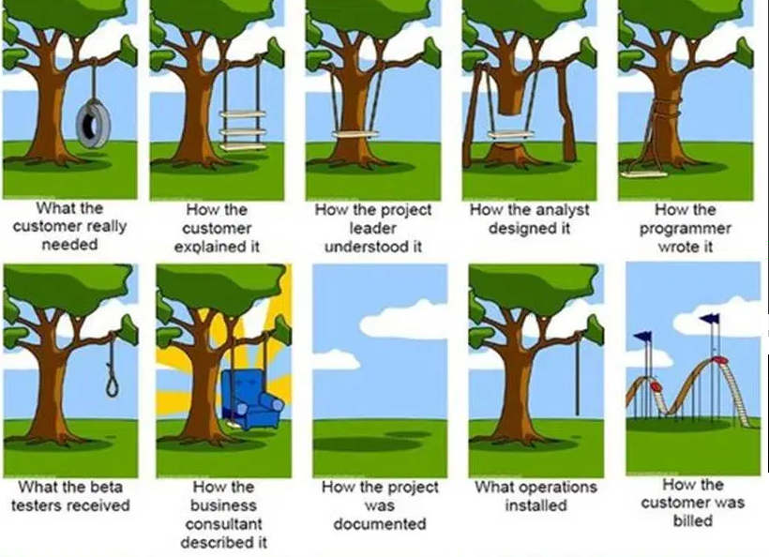
Significance of Verification

Slide 11
Specification or Verification-Need
Specification of a program
Logical structure of formal specification written as a formula
Act as a guiding principle to implementation
Important in documentation
Resolves issues
Time and cost
Debugging big system during testing phase is costly and time consuming
Local fix can introduce new bugs at other places
Verification eliminate most errors in planning phase, cut down the duration of software development , clarify the roles.

Slide 12
Specification or Verification-Need
Refactoring
Properly specified and verified software is easier to reuse
Certification
Safety critical systems demand specification and verification
Eg. Control of cooling system in nuclear power plant
Cockpits of modern aircrafts.
Commercially critical programs require program verification as warranty
Eg. Software used by banks

Slide 13
Formal verification Techniques
Formal verification techniques can be thought of as comprising three parts:
a framework for modelling systems, typically a description language of some sort;
a specification language for describing the properties to be verified;
a verification method to establish whether the description of a system satisfies the specification.

Slide 14
Classification of verification Techniques
Verification techniques are classified based on
Verification method
Proof based, model based verification
Degree of automation
Automatic, semiautomatic and manual verification
Specification describing the system
Property verification(expensive to verify), full behavior verification
Domain of application
hardware or software
sequential ( single processor) or concurrent (multiple processor)
reactive or transformational
Stage of system development
Pre development and post development

Slide 15
Transformational vs Reactive
Transformational programs
Program takes an input and after some computation expected to terminate with an output
Reactive systems
Not intended to terminate and that react continually with their environment
e.g., operating systems, embedded systems and computer hardware

Slide 16
Model Checking
model checking is an automatic, model based, property-verification approach.
It is intended to be used for concurrent, reactive systems and originated as a post-development methodology.
Concurrency bugs are among the most difficult to find by testing
Used when input is limited since checking is done for each input

Slide 17
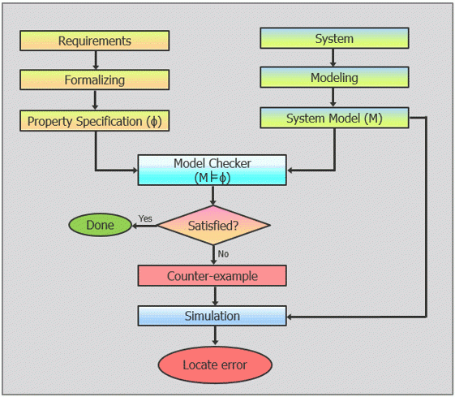
FV Technique: Model checking
Model checking, also known as property checking, is a state-based approach to formal verification.

Slide 18
Proof based verification
the system description is a set of formulas Γ (in a suitable logic) and the specification is another formula φ. The verification by finding proof
Program variables can have infinitely many interacting values
Do not check for every state as model checker
Use Proof calculus

Slide 19
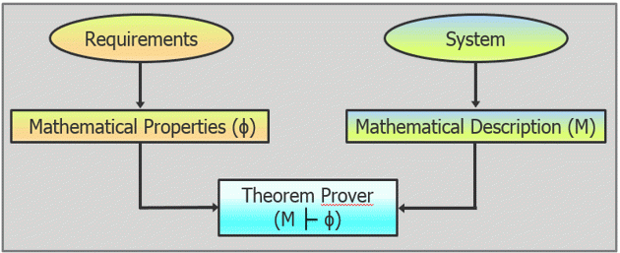
FV Technique: Theorem proving
Process of verifying that the implemented system meets design requirements (or specifications) using mathematical reasoning.
Used for code based verification
It is a proof-based approach to formal verification.

Slide 20
FV Technique: Theorem proving
Advantage:
it can handle very complex systems.
Limitations:
It is not fully automatic - it requires manual intervention to complete the proofs.
in case of a failed proof, no counter-examples are generated, which makes locating the error difficult

Slide 21
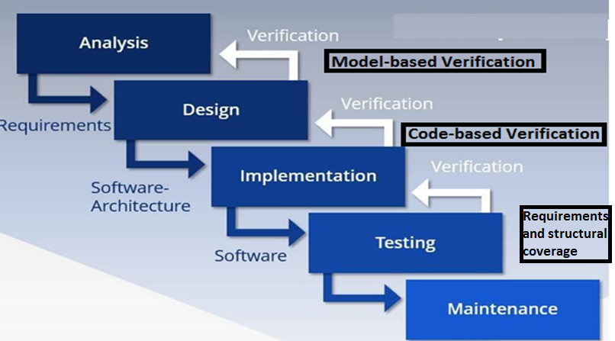
Formal verification in development process
Reference: Yannick Moyet.al. Testing or Formal Verification, DO-178C Alternatives and Industrial Experience, IEEE software, 2013.

Slide 22
Rigorous Software Verification
Start with formal specification of correctness:
- functional correctness
input-output correctness
- behavioral correctness
security, no deadlocks, liveness
Two broad approaches:
- code-based verification (e.g., Frama-C)
- model-based verification (e.g., SPIN)
Testing, run-time analysis and debugging also important.
Reference: Dr.Bharat Jayaraman, Unviversity of Buffalo, CSE449-459 Software verification course, Spring 2020.

